Slide 1

Evolution of Indian Retail business
SWOT Analysis from Mom-and-Pop Stores to E-Commerce Giants"
Presented by : Amit kumar
Roll Number :21f3002445

Slide 2
Retail business in India
Business involved in the sale of goods and services directly to consumers for personal, non-business use.
Contribution of retail industry to GDP is 10%
Traditional Retail
(Pre-1990s)
Mom-and pops store, street market, local bazar
Modern Retail Formats
(1990s-2010s)
Big Bazar, Reliance Retails , Omnichannel retailing, Membership-based retailers
E-commerce Boom
(2010s-)
Flipkart, Amazon, Paytm Mall, Big Basket
Source : -https://www.linkedin.com/pulse/evolution-retail-india-globallaunchbase/

Slide 3


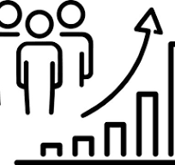



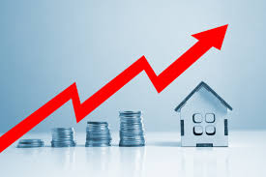
Strength
Weakness
Purchasing Power: 470 million people in the emerging middle class. They have capability to buy various type of product.
Population Demographics: working population is expected to be 117 million .
Low Retail Penetration: in India is still very low at 6 to 8%, especially when compared to developed nations such as the US and the UK
Digital Revolution: 900 million internet users by 2024.
Infrastructure Challenges: logistics costs are approximately 13-14% of GDP, compared to 8-9% in developed countries
Limited Use of Technology: 4-5% of small retailers uses POS system
Large number of unorganised business: 88% of the total retail market
High Real Estate Costs: Renting or purchasing retail space in prime locations can be expensive, impacting profitability
Source:-https://www.ibef.org/industry/indian-retail-industry-analysis-presentation

Slide 4
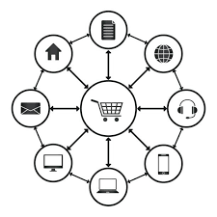
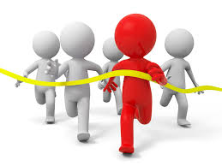
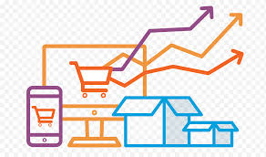



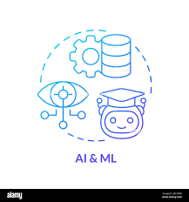

Opportunity
Threat
Competition from unorganized sector: Traditional small stores and vendors still dominate the market.
Economic Uncertainty: Unpredictable nature of the economic environment, which can impact consumer behavior, business operations, and overall market conditions
Changing Consumer Preferences: India is price sensitive market
Regulatory Changes: Navigating complex regulations and compliance requirements
Omnichannel Strategies: Integration of online and offline channels for seamless customer experiences
E-commerce Growth: Online shopping is rapidly growing in India, offering retailers new ways to reach customers.
Tier 2 and Tier 3 Cities: These cities have a large, untapped consumer base that retailers can target.
Technology adoption: Technologies like AR/VR, AI, and data analytics can improve customer service, supply chain management, and marketing.
More details :- https://www.ibef.org/industry/indian-retail-industry-analysis-presentation

Slide 5
Conclusion and Recommendation
India's retail sector is a land of opportunity:
Highlight the growth potential due to rising income, booming e-commerce, and increasing tech adoption.
Embrace omnichannel strategies:
Emphasize the importance of integrating physical and online stores for a seamless customer experience.
Challenges require innovation:
Acknowledge the competition from unorganized retail, expensive real estate, and a complex supply chain. However, frame it as an opportunity to innovate and improve efficiency.
The customer is king:
Reinforce the need to adapt to evolving consumer preferences and buying habits.

Slide 6
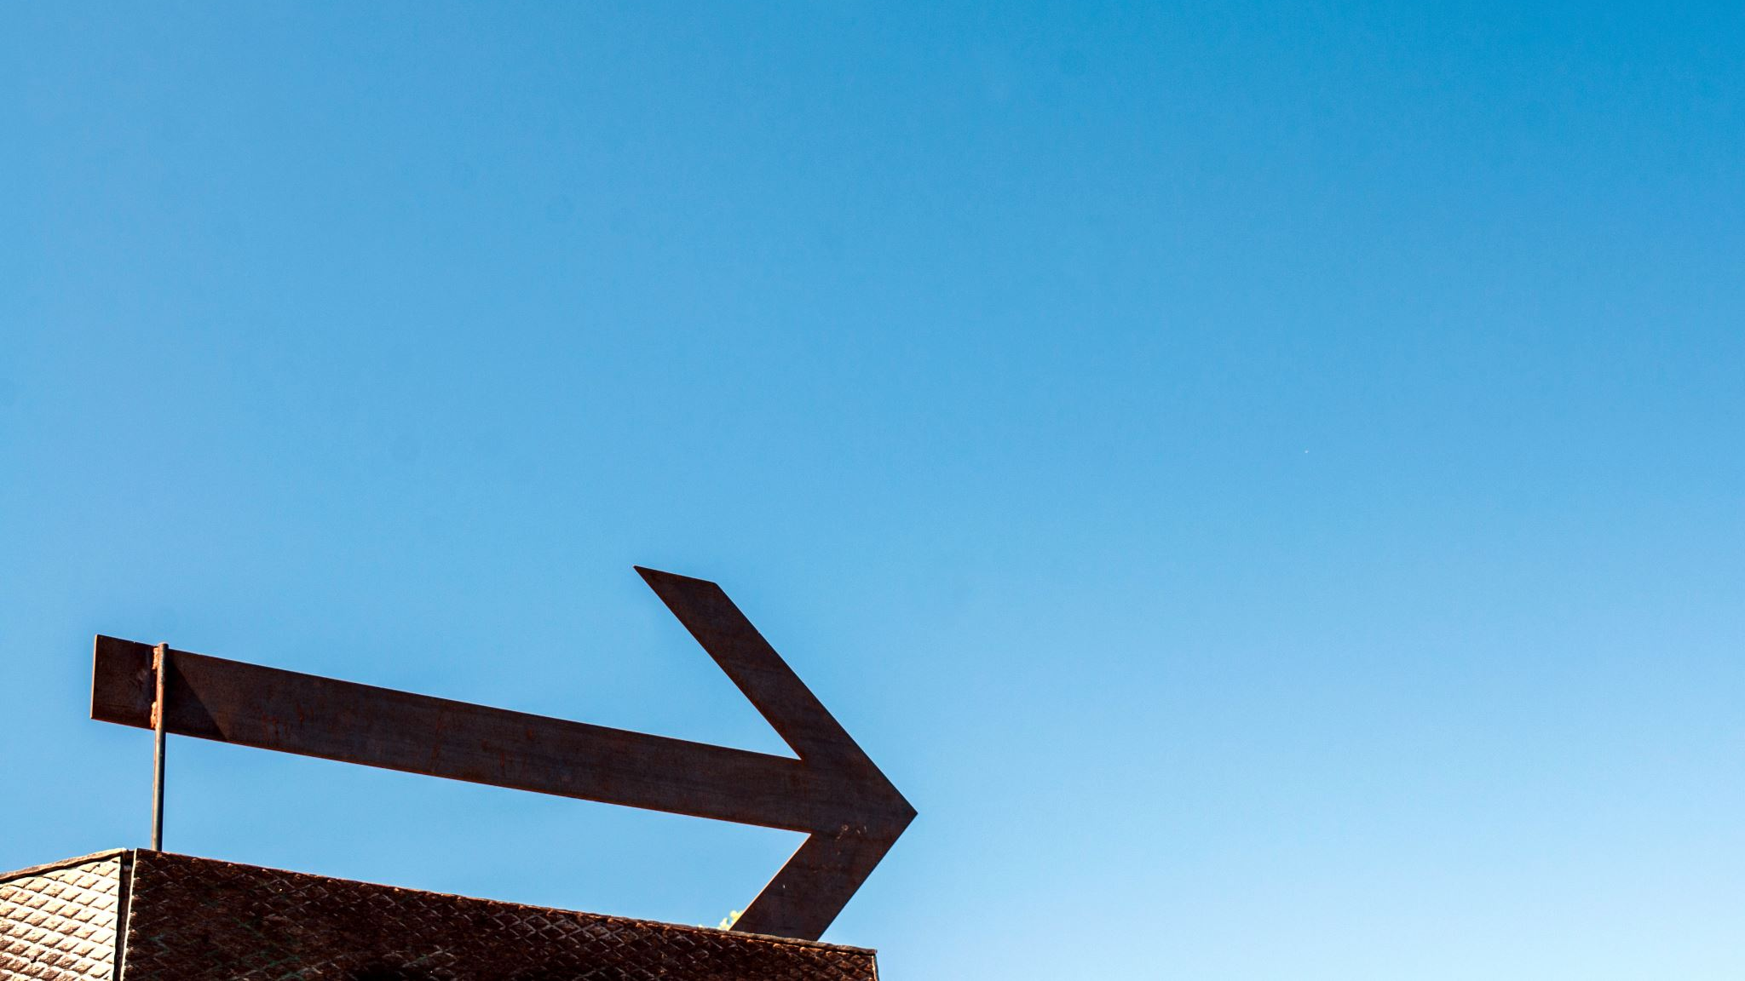
Thankyou for Listening
Ask Question

